Slide 1

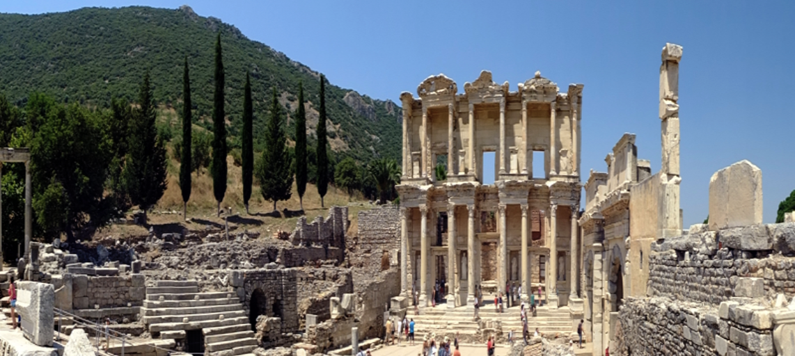
Epistle to the Ephesians
Please click on icon for audio

Slide 2
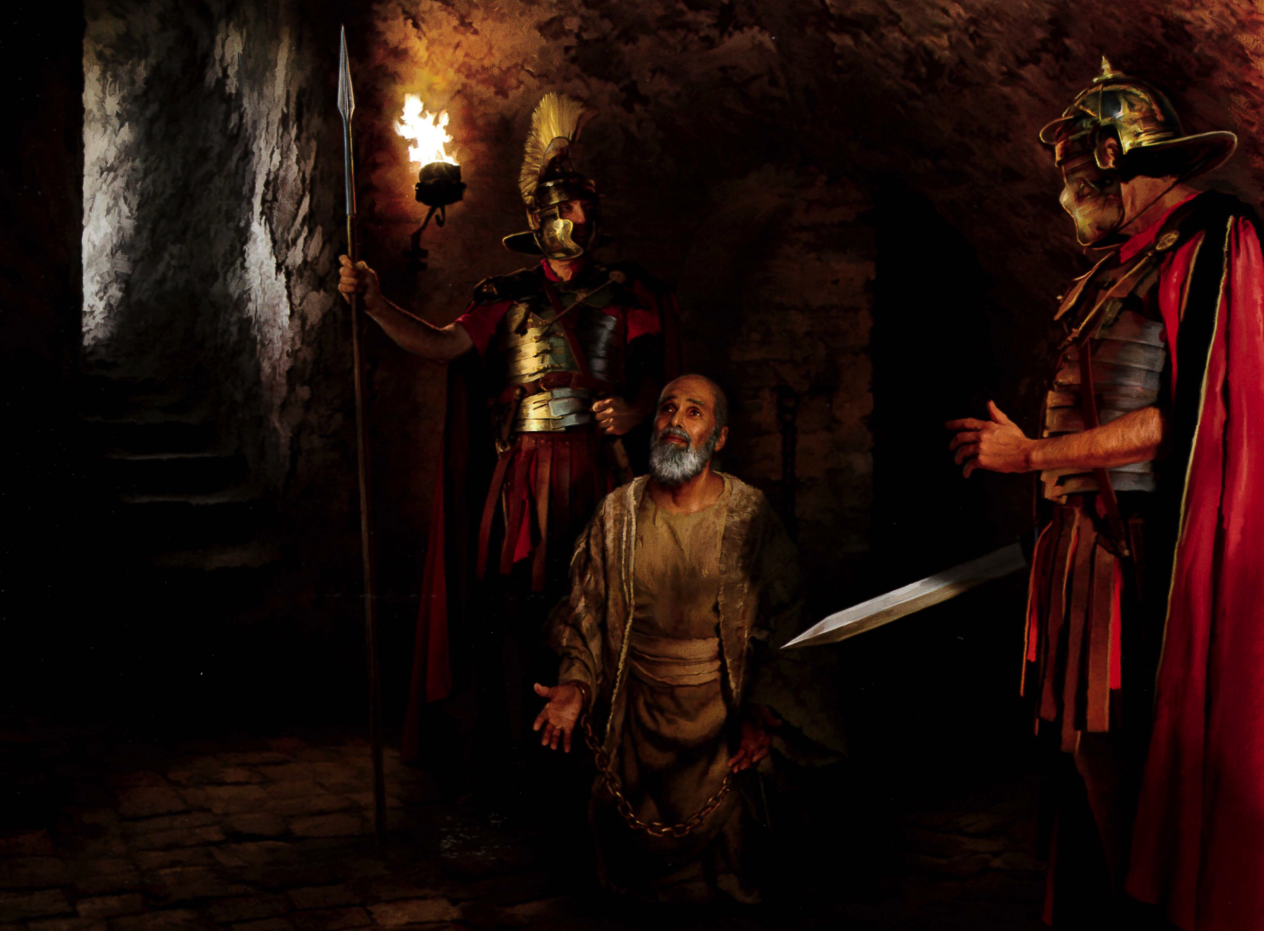
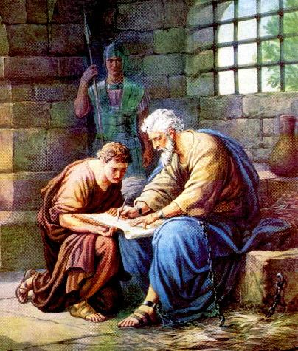
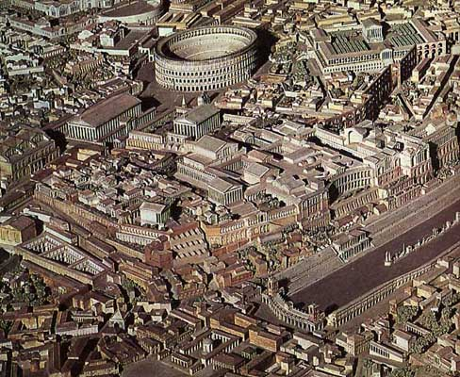
Paul in Rome
Acts 28
*Approximately A.D. 61-63 THE END
*What is the last thing we know about Paul from Acts?
Acts 28:30–31
³⁰ And Paul dwelt two whole years in his own hired house, and received all that came in unto him, ³¹ Preaching the kingdom of God, and teaching those things which concern the Lord Jesus Christ, with all confidence, no man forbidding him.

Slide 3
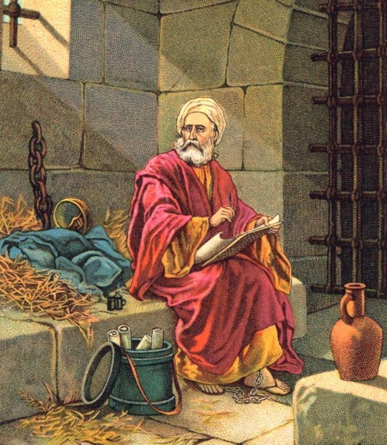
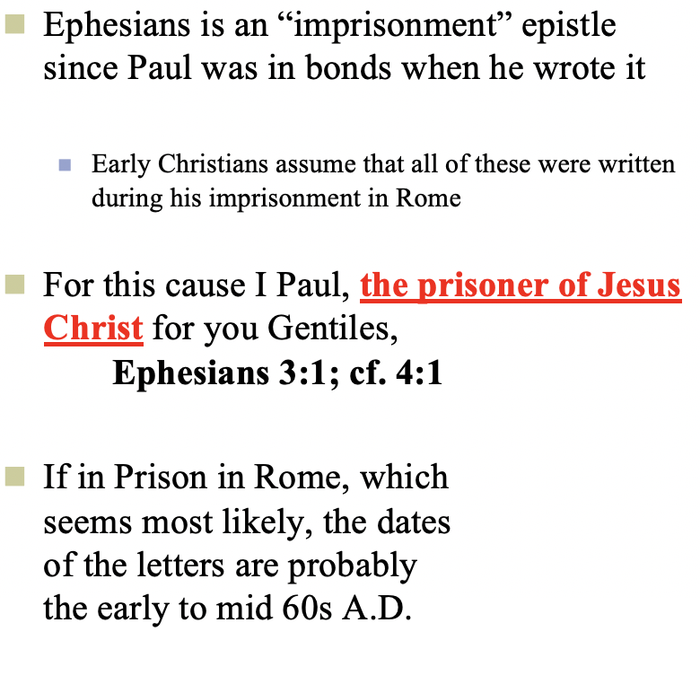
Writing from Prison

Slide 4
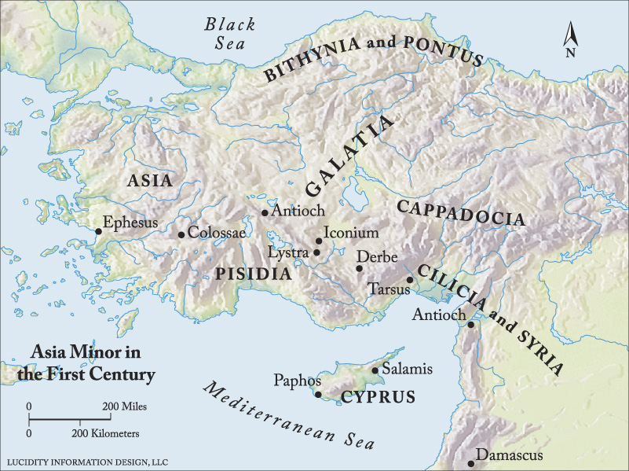
Philemon
Colossae
Ephesus
.Laodicea
Laodicea
Colossae

Slide 5
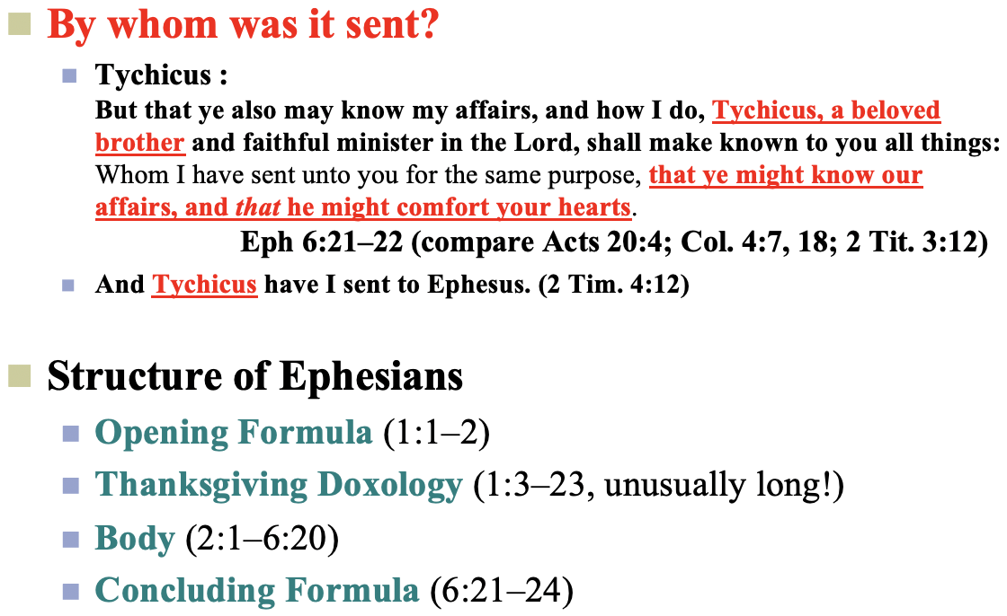
Ephesians

Slide 6
Paul and “Predestination” Again
“According as he hath chosen us in him before the foundation of the world, that we should be holy and without blame before him in love: Having predestinated us unto the adoption of children by Jesus Christ to himself, according to the good pleasure of his will . . . In whom also we have obtained an inheritance, being predestinated according to the purpose of him who worketh all things after the counsel of his own will . . . (1:4–5, 11–12)
  Predestine = “decide from the beginning or beforehand, predestine, foreordain; set apart from the beginning or beforehand (proorizō).
¹¹ In whom also we have obtained an inheritance, being predestinated according to the purpose of him who worketh all things after the counsel of his own will:
¹² That we should be to the praise of his glory, who first trusted in Christ.
¹³ In whom ye also trusted, after that ye heard the word of truth, the gospel of your salvation: in whom also after that ye believed, ye were sealed with that holy Spirit of promise,
¹⁴ Which is the earnest of our inheritance until the redemption of the purchased possession, unto the praise of his glory. Ephesians 1:11–14
“the earnest of our inheritance”
=
“who is the down payment of our inheritance”

Slide 7
Saved by Grace
Ephesians 2:1–10
“For by grace are ye saved through faith; and that not of yourselves: it is the gift of God: Not of works, lest any man should boast.” (2:8–9)
  are ye saved: Salvation, perhaps broader than the straightforward justification of Galatians and Romans
    Resurrection: free gift, “unconditional grace”
    Redemption: the gift of forgiveness that comes with justification, still a gift but one that we put ourselves in a position to receive, sometimes termed “conditional grace” which comes in return for faith
  through faith: not just belief but trust in Christ that causes us to take him at his word, lay hold of the gift that he offers
    Exposition: taking Christ at his word means trusting that when we believe in him, repent, and are baptized we will be forgiven!
For we are his workmanship, created in Christ Jesus unto good works, which God hath before ordained that we should walk in them. Ephesians 2:10

Slide 8
Ephesians 2:20-21
And are built upon the foundation of the apostles and prophets, Jesus Christ himself being the chief corner stone; In whom all the building fitly framed together groweth unto an holy temple in the Lord
Church Structure
Ephesians 4:11-12
And he gave some, apostles; and some, prophets; and some, evangelists; and some, pastors and teachers; For the perfecting of the saints, for the work of the ministry, for the edifying of the body of Christ:
Pastors
Jesus Christ
Evangelists
Teachers
Apostles and Prophets
One Lord, one faith, one baptism.
Ephesians 4:5

Slide 9
Church Structure
Paul’s Counsel to the Ephesian Elders:
²⁷ For I have not shunned to declare unto you all the counsel of God. ²⁸ Take heed therefore unto yourselves, and to all the flock, over the which the Holy Ghost hath made you overseers, to feed the church of God, which he hath purchased with his own blood. ²⁹ For I know this, that after my departing shall grievous wolves enter in among you, not sparing the flock. ³⁰ Also of your own selves shall men arise, speaking perverse things, to draw away disciples after them.
³¹ Therefore watch, and remember, that by the space of three years I ceased not to warn every one night and day with tears. Act 20:27–31
Pastors
Notes:
^{KJV} Ephesians 4:14 That we henceforth be no more children, tossed to and fro, and carried about with every wind of doctrine, by the sleight of men, and cunning craftiness, whereby they lie in wait to deceive; (Eph 4:14 KJV)

Slide 10
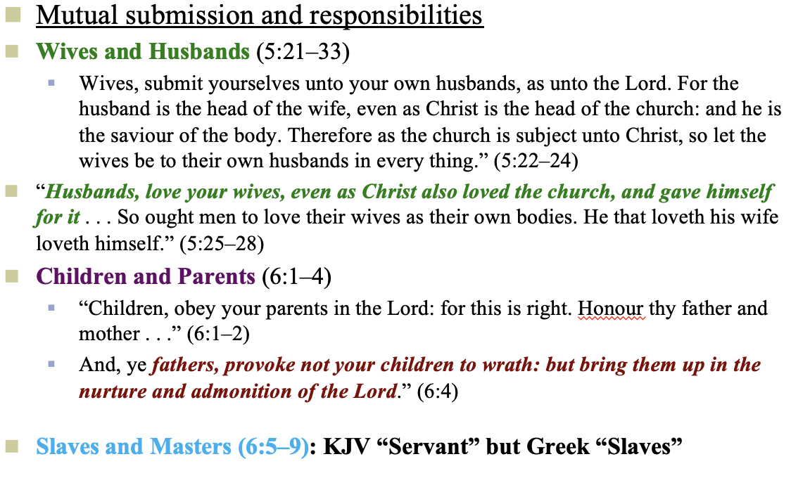
Serving Each Other
Household Code, Ephesians 5:21–6:9

Slide 11
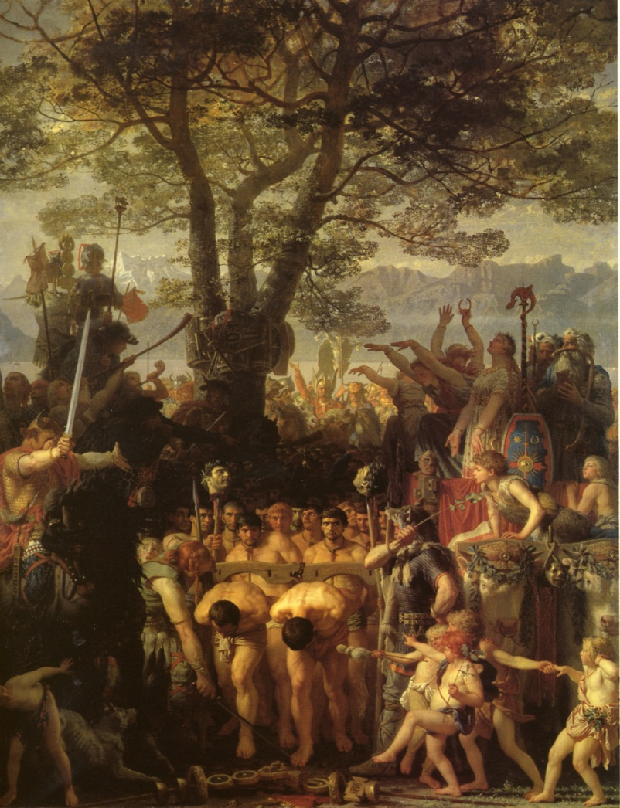
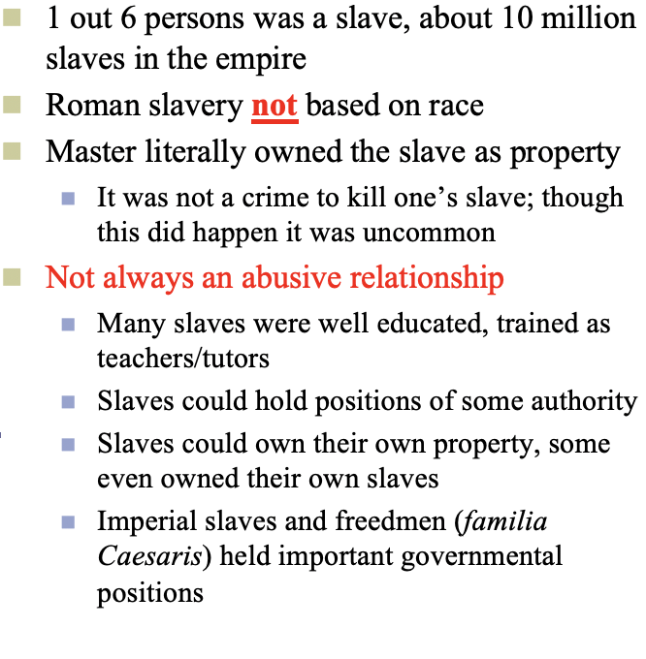
Roman Slavery
Charles Gleyre
Jewish Slavery
Recognized in the Law of Moses
Not Racial
Temporary (6 years)

Slide 12
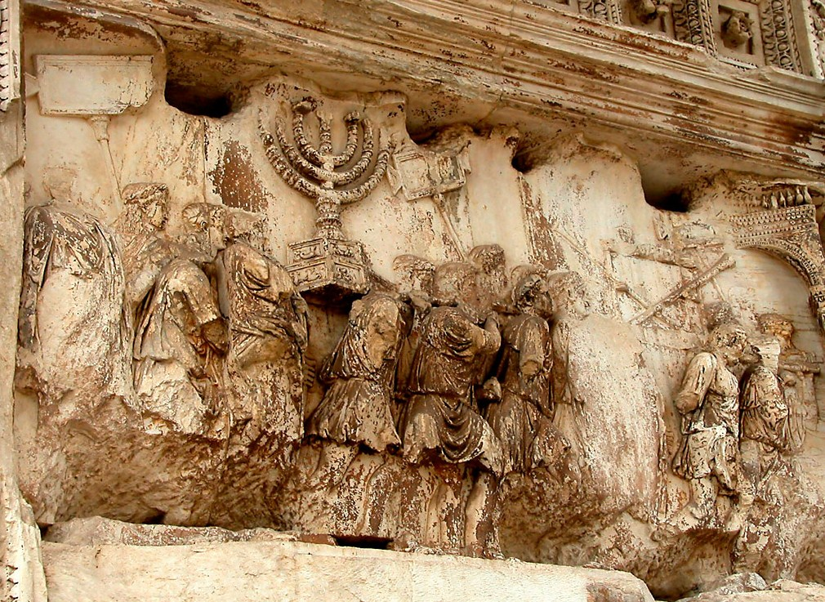
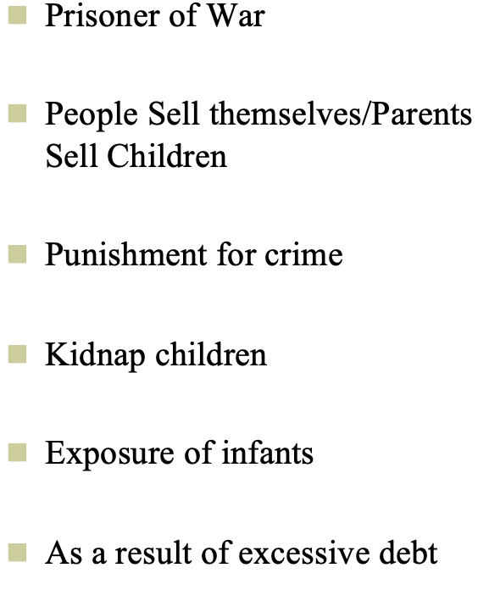
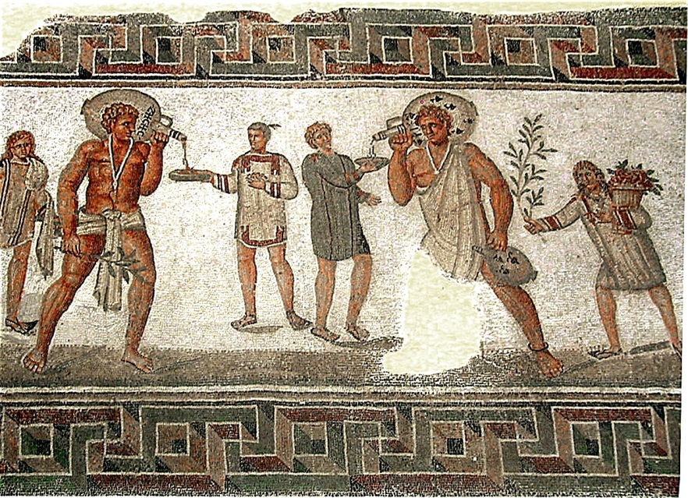
Ways to Become a Roman Slave

Slide 13
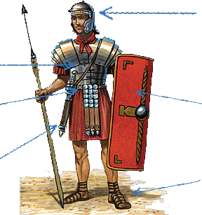
Armor of God
Ephesian 6:11–18
Finally, my brethren, be strong in the Lord, and in the power of his might.
Ephesians 6:10
helmet of salvation, v. 17
the breastplate of
righteousness, v. 14
taking the shield of faith, wherewith ye shall be able to quench all the fiery darts of the wicked. v. 16
having your loins girt about with truth, v. 14
sword of the Spirit, which is the word of God: v. 17
feet shod with the preparation of the gospel of peace, v. 15

Slide 14
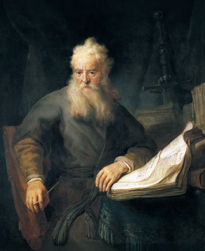
¹⁸ Praying always with all prayer and supplication in the Spirit, and watching thereunto with all perseverance and supplication for all saints;
¹⁹ And for me, that utterance may be given unto me, that I may open my mouth boldly, to make known the mystery of the gospel,
²⁰ For which I am an ambassador in bonds: that therein I may speak boldly, as I ought to speak.
²¹ But that ye also may know my affairs, and how I do, Tychicus, a beloved brother and faithful minister in the Lord, shall make known to you all things:
²² Whom I have sent unto you for the same purpose, that ye might know our affairs, and that he might comfort your hearts.
²³ Peace be to the brethren, and love with faith, from God the Father and the Lord Jesus Christ.
²⁴ Grace be with all them that love our Lord Jesus Christ in sincerity. Amen.
Ephesians 6:18–24

